Slide 1
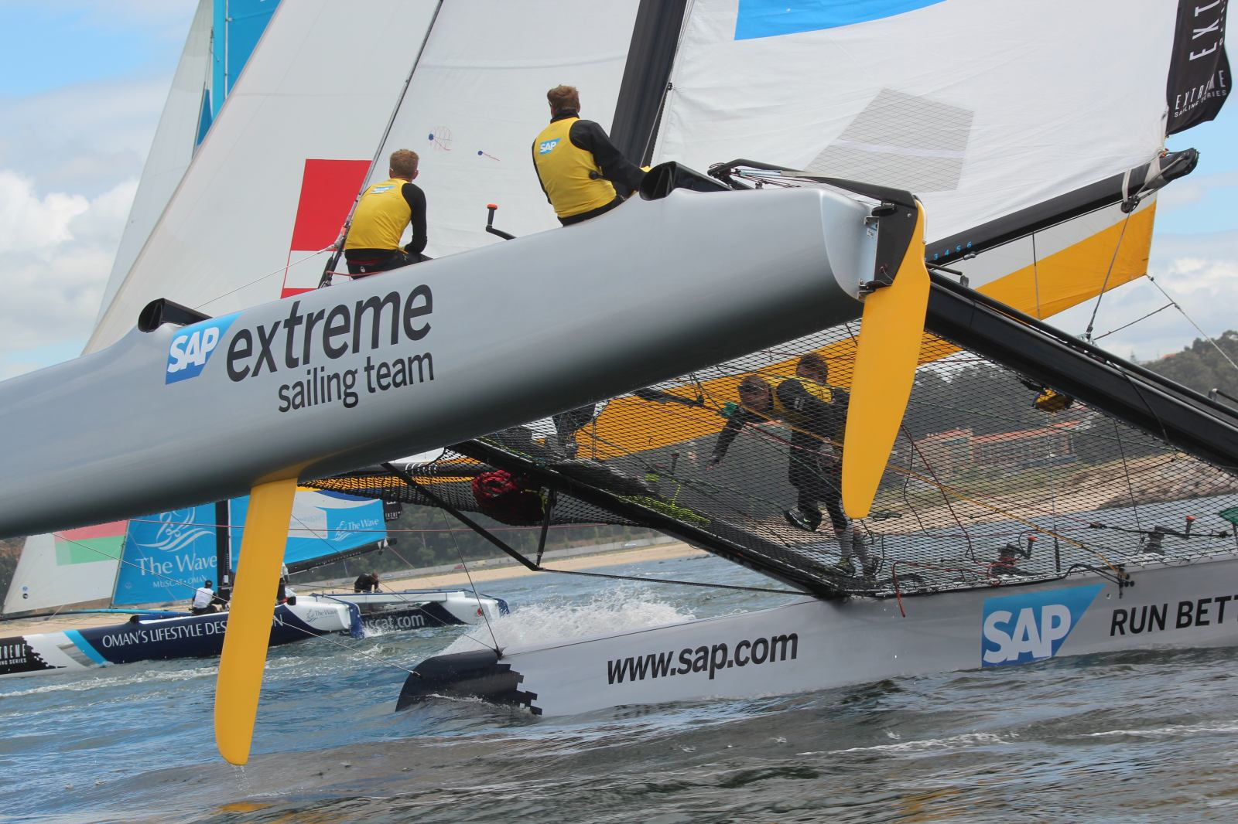

SAP Sailing Analytics
A Compact Overview of our Program
Axel Uhl, Global Sponsorships
November 11, 2013

Slide 2
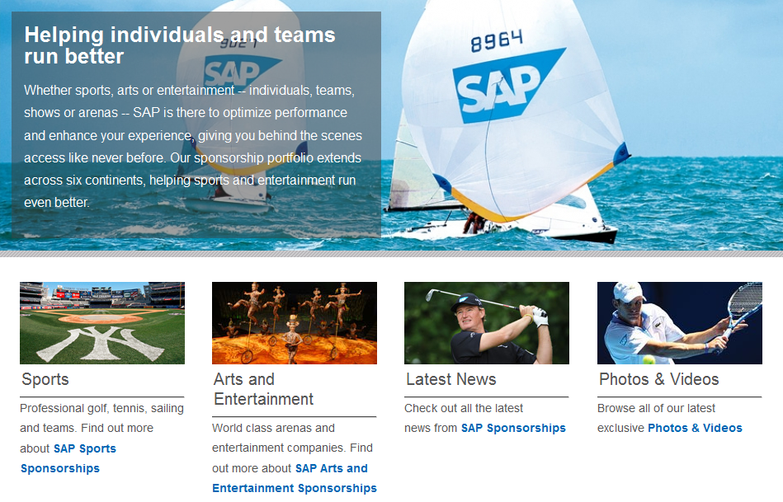

Slide 3
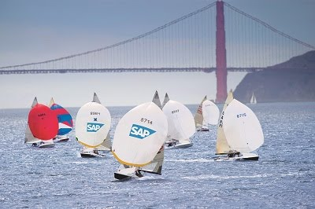

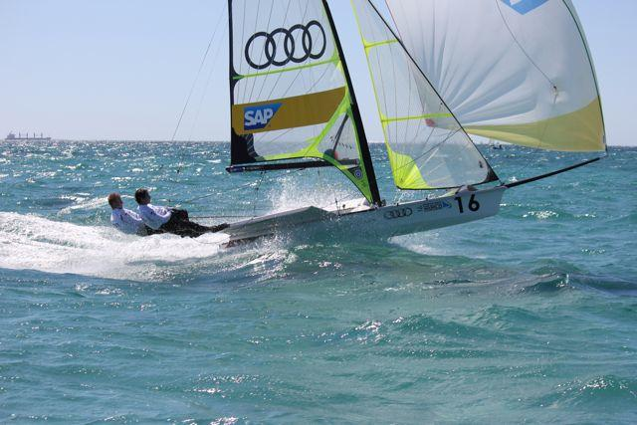
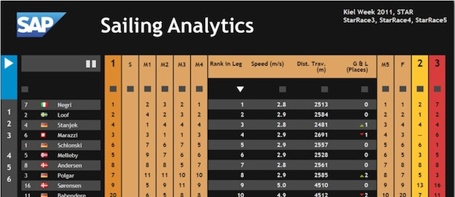
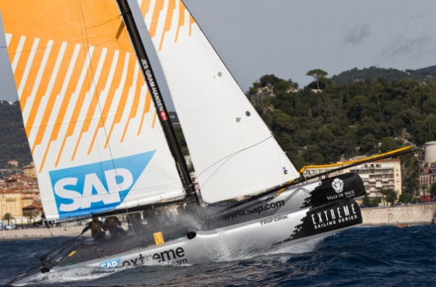
History of Sailing in Global Sponsorships
SAP Sponsors the 5o5 Worlds Since 2009
Hospitality Program
Since 2010 Tracking-Based Analytics
Kieler Woche 2011-2013
First Live Leader Board with Basic Live Analytics in 2011 (e.g., Speeds, Distances, Wind)
Various Smaller Events with Live Analytics
IDM Travemünde, MdM Hamburg, Young Europeans Sailing Kiel, BMW Sailing Cup Wannsee, Berlin Match Race, Dragon IDM Wannsee, 49er Euros Lake Garda, …
Extreme Sailing Series
Live Analytics for the last three acts of 2012
Official Score Keeper and Analytics Provider for the 2013 Series
See http://sapsailing.com

Slide 4
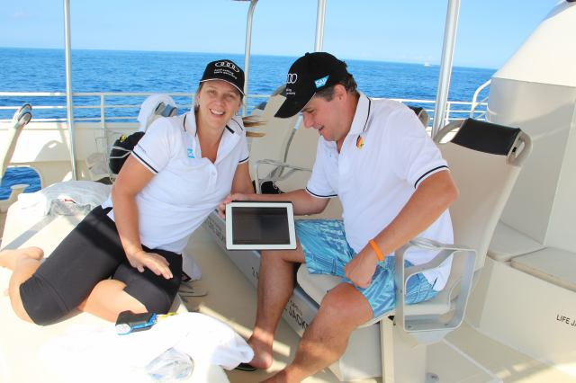
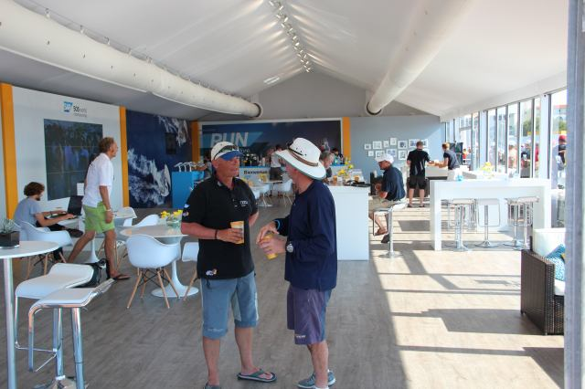
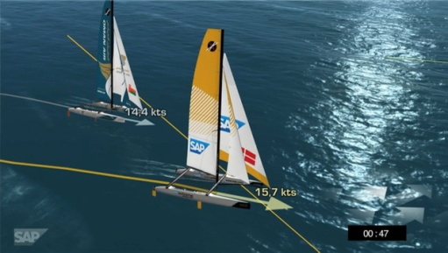
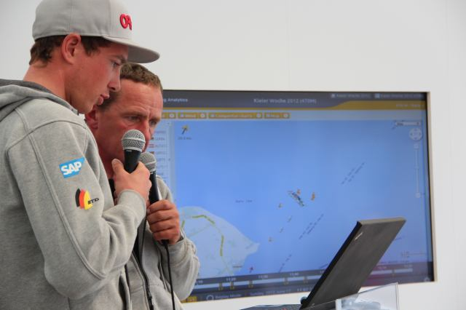
Typical Event Set-Up
Hospitality Program with Spectator Boats
Live Race Analytics shown to spectators on tablets
Lounge
iPads and big screens
On-Shore Viewers
Online live program with scheduled racing times and course areas
Live 2D / 3D Course and Race Visualization on shore
Live Internet streaming with commentary
Sailors Debrief using the SAP Sailing Analytics

Slide 5



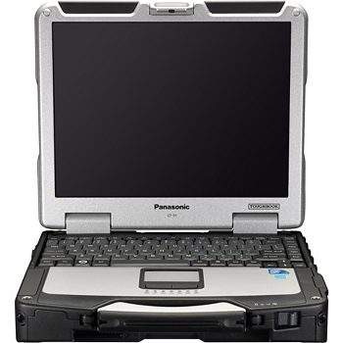
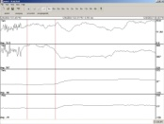





SAP Sailing Analytics System Landscape and Data Flow
sapsailing.com
Wind measurement
HTTP
Expedition
Toughbook
TCP
UDP
TCP
UDP
Mobile hotspot
GSM / GPS Boat Tracker

Slide 6
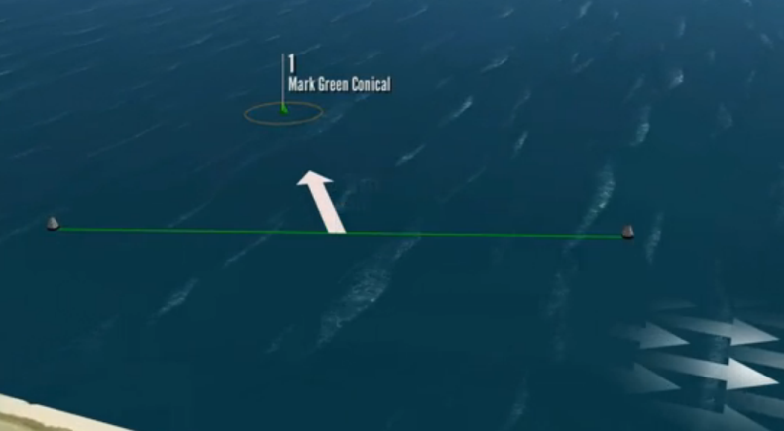
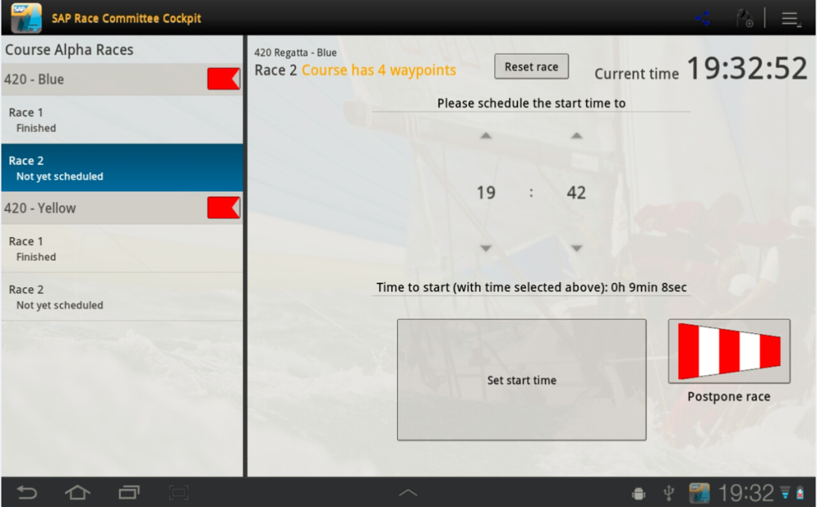
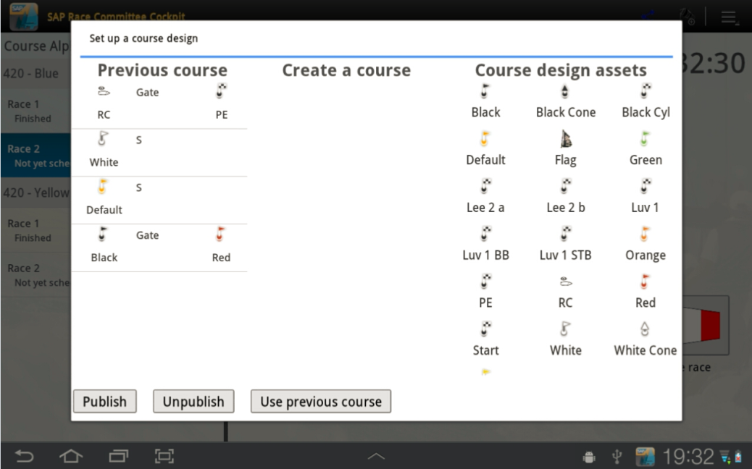
Android App for Race Committee Support
Announces Course and Race Start Time
Will be used for final result entry

Slide 7
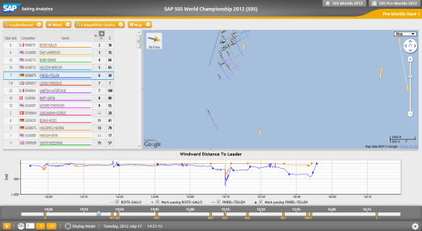
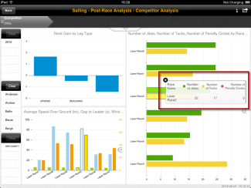
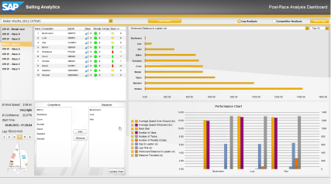
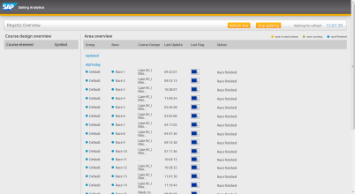
SAP Sailing Analytics and Additional Components
LIVE & Replay Mode
SAP BusinessObjects
SAP BI Platform
GPS Tracking
GPS Data
SAP Sailing Analytics
Explorer
Wind Data
SAP HANA
Wind Sensors
Dashboards
Regatta Overview
Race Committee App
LIVE
Post-Race

Slide 8
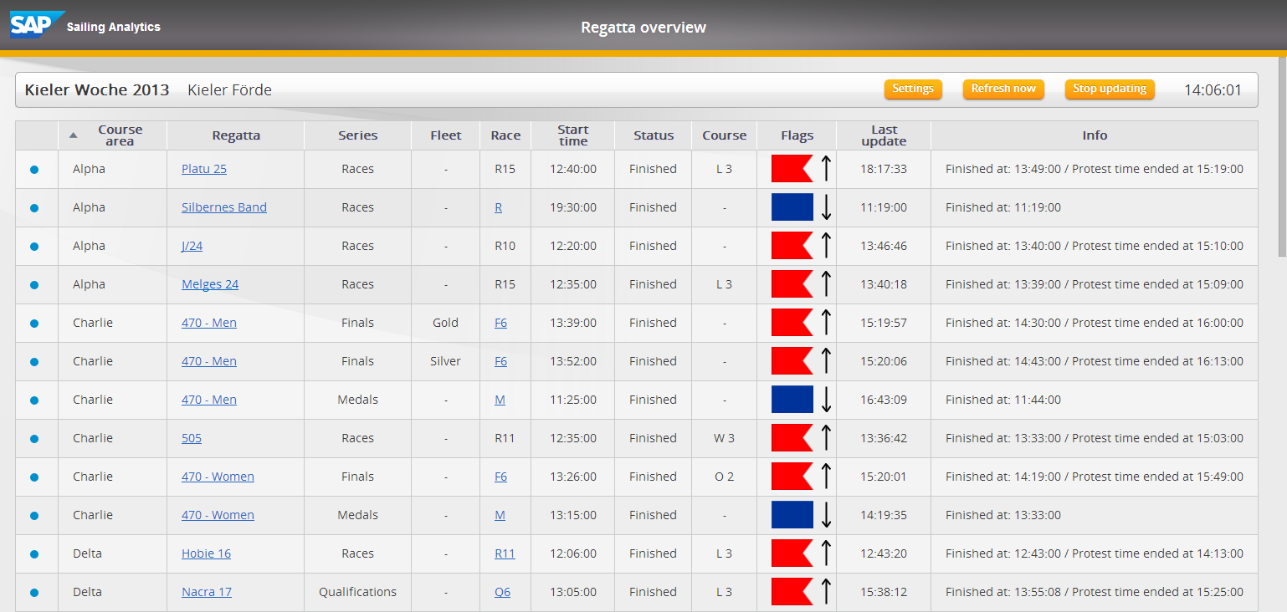
Regatta Overview
Based on Race Committee App and SAP Sailing Analytics
Provides overview of races and their status, linking to SAP Sailing Analytics

Slide 9
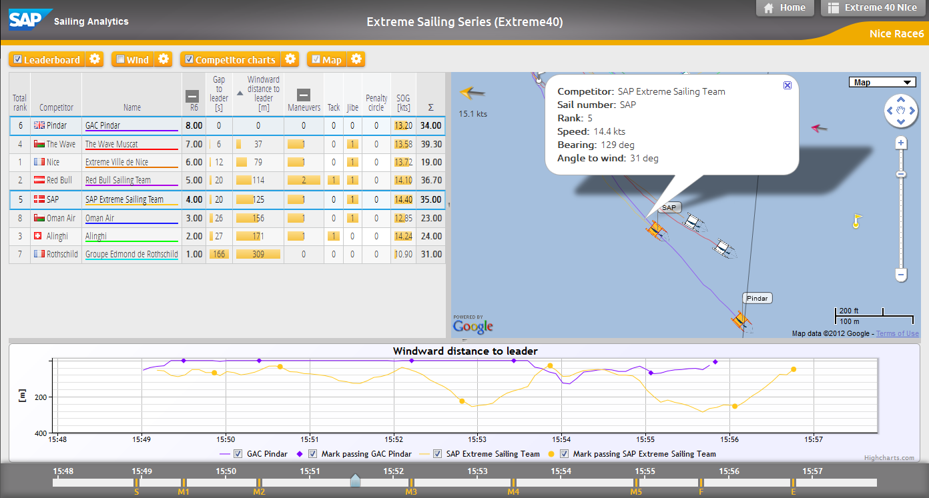
Analyzing a Single Race While It’s Live or When It’s Over

Slide 10
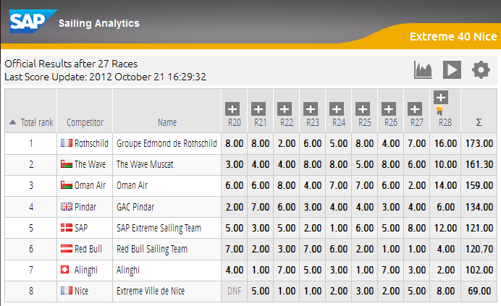
Live Regatta Leaderboard Based on Live Tracking

Slide 11

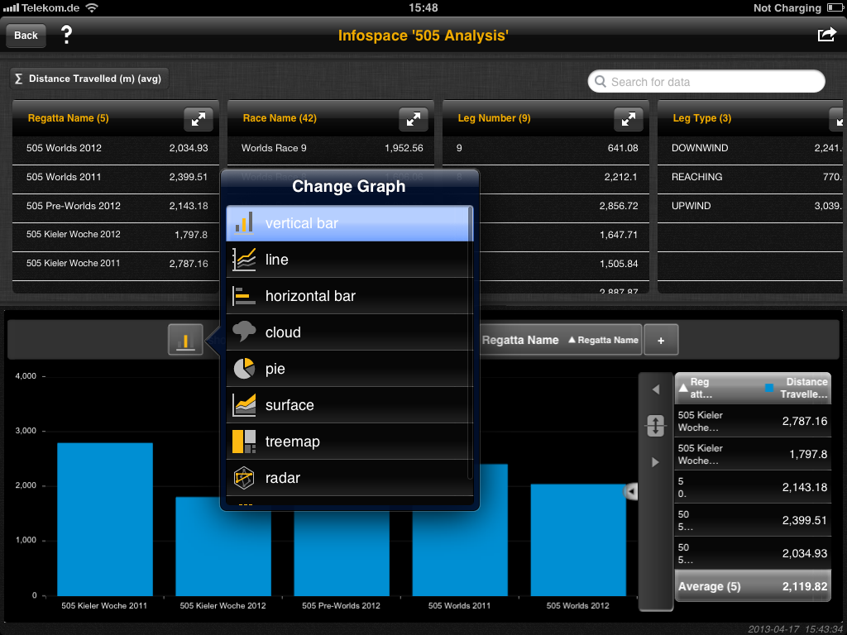
Post-Race Analytics
iPad and Desktop tools for analyzing large historic sail race database

Slide 12
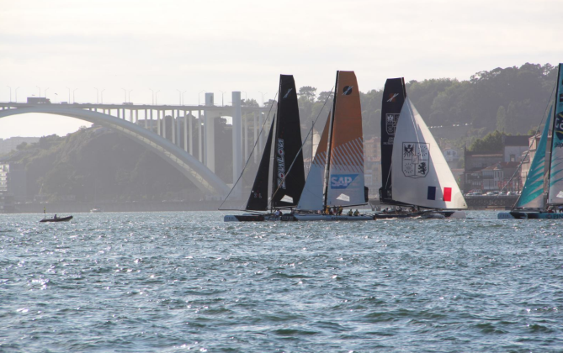
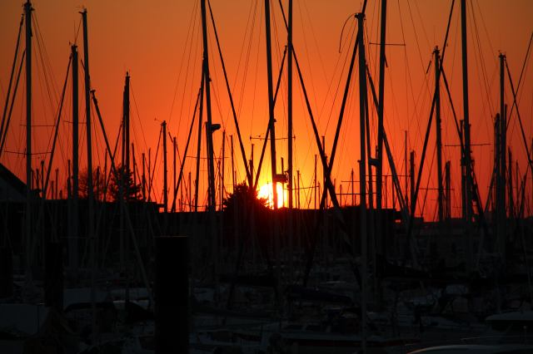
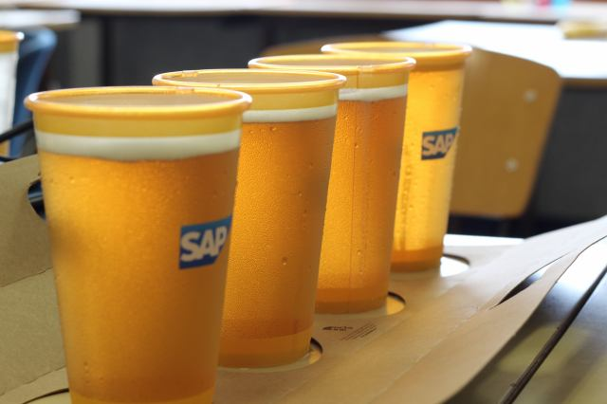
Thank you
Contact information:
axel.uhl@sap.com

